Slide 1
ANALYTIC APPROACH OF EMPLOYEE ATTRITION USING K-NEAREST NEIGHBORS ALGORITHM
Presented By
NAME: VIJAY . S
REGISTER NO: 39120135
Guided By
DR . Jeberson Retna Raj . M.Tech..,
Phd..,

Slide 2
PRESENTATION OUTLINE
Course Certificate
Objectives
Abstract
System Requiremets
Architectural Diagram
Project Modules
Conclusion
Reference

Slide 3
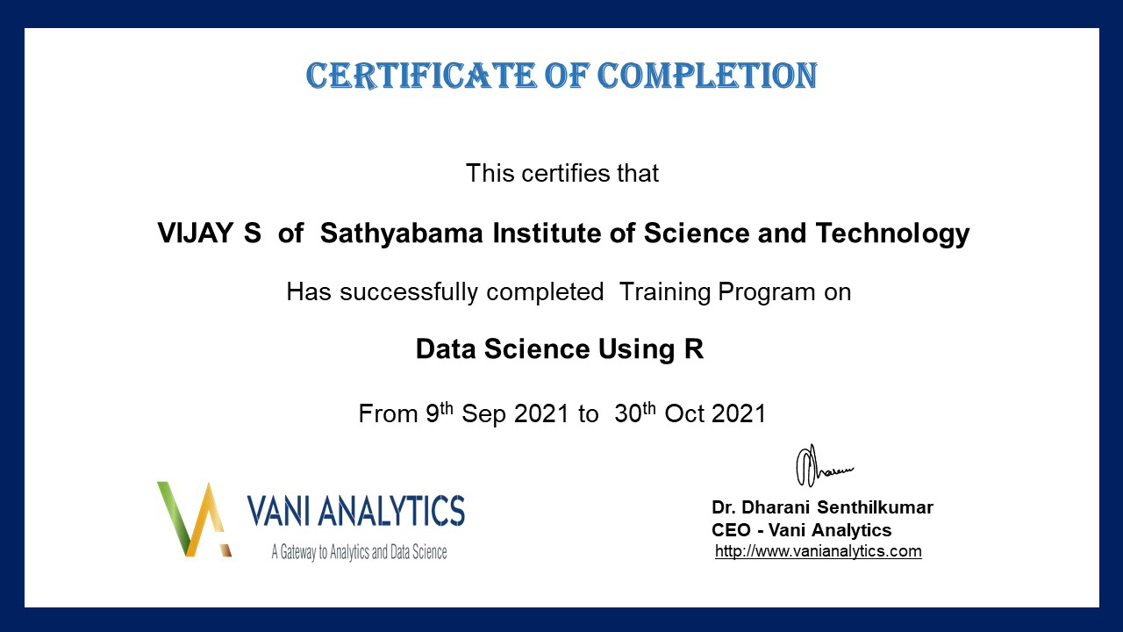
COURSE CERTIFICATE

Slide 4
OBJECTIVE
The goal of this project, is to predict whether a developer will leave the company or not after certain period of time based on the monthly report.
For prediction, K Nearest Neighbors algorithms is used to classify and predict the developer turnover using factors
Such as satisfaction_level, last_evaluation,number_projects, average_monthly_hours, time_spent_company, etc.

Slide 5
Abstract
Data Science trends have been developed and various research are going on in this field. Employee turnover has become a big challenge for Information Technology companies.
The departure of key software developers might cause big loss to an IT company since they also depart with important business knowledge and critical technical skills.
Understanding employee turnover is very important for IT companies to retain talented developers and reduce the loss due to developers' departure.
In this Project, monthly self-report of the software developers includes developer’s activities, working hours, no of projects they have been assigned etc., have been taken in to account for analysis for doing the prediction with the help of Data Science algorithm.
By using, K-Nearest Neighbors classification algorithm, Classification and Prediction model have been created. This K-Nearest Neighbors model will predict whether the employee will leave the company or not.

Slide 6
Hardware Requirements
Processor : Processor Intel CORE i3 and above
Internet Connection : Existing telephone lines, Data card, Fiber net
RAM : 4 GB
Software Requirements
Operating System : Windows, Mac, Linux
Language : R Programming – R-4.1.1
GUI : RStudio

Slide 7
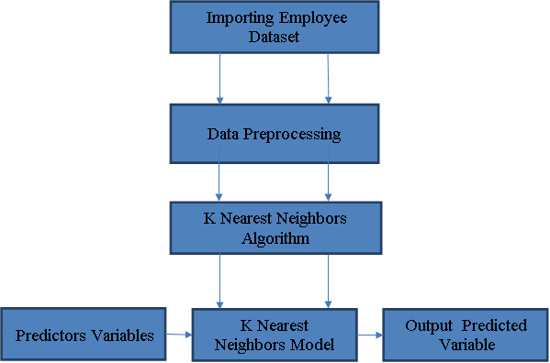
Architectural Diagram

Slide 8
Project Modules
There are four Modules
Importing Employee dataset
Data Preprocessing
Model Generation Using K-Nearest Neighbors Algorithm
Prediction using K-Nearest Neighbors Model

Slide 9
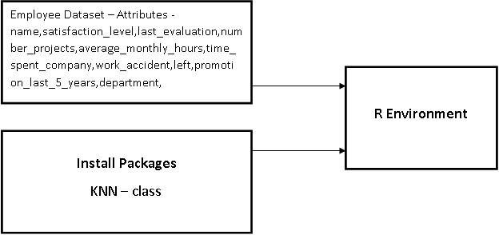
Importing Employee Dataset
Data have to be imported in to R environment for analysis.
Data can be any format like txt, .csv, .xlsx, .SPSS etc.
Packages necessary for classification algorithm – K Nearest Neighbors have to be installed into the R environment. KNN – class

Slide 10
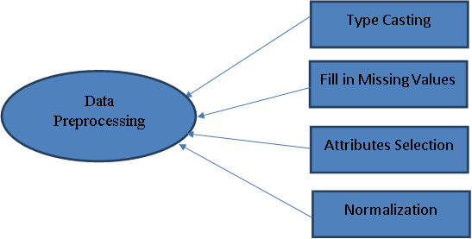
Data Preprocessing
In Data Preprocessing, it is not necessary to hold all the attributes for doing the analysis, we can hold only the attributes which is affecting the analysis.
.

Slide 11
Model Generation Using KNN Algorithm
KNN – K Nearest Neighbour is used for both Classification and Regression. Classifying the data points based on how its neighbour are classified.
Let (Xi,Ci) Xi denotes feature value, Ci denotes labels(Class) for each Xi.
Let X be the data point for which label have to be find out using KNN
KNN Algorithm:
1. Calculate D(X,Xi) i=1,2,3,..n; where d denotes Euclidean distance between data points.
2. Arrange the calculated n Euclidean distances in increasing order.
3. Let K be a +ve integer, take first K distances from the sorted list.
4. Let Ki denotes the number of points belonging to the i^{th} class among k points.
5. If Ki >Kj then put X in Class i.

Slide 12
Model Generation Using KNN Algorithm
How to choose the K value is sqrt(no of data points)
Odd value of K is selected to avoid confusion between the 2 classes.
Weight | Height | Class
51 | 167 | Underweight
62 | 182 | Normal
69 | 176 | Normal
64 | 173 | Normal
65 | 172 | Normal
56 | 174 | Underweight
58 | 169 | Normal
57 | 173 | Normal
55 | 170 | Normal
On the basis of given data classify the following dataset
Weight = 57 kg
Height = 170cm
Class= ?

Slide 13
Model Generation Using KNN Algorithm
Calculate the Euclidean distance of new data point from all the points.
Weight = 57 kg
Height = 170 cm
Class= ?
Euclidean distance between 2 points (x,y) and (a,b) is
dist(d) = sqrt((x-a)^2 + (y-b)^2)
Let K=3
ED for 1st data point
Sqrt((57-51)^2 + (170-167)^2)= 6.7
Weight | Height | Class | Euclidean Distance
51 | 167 | Underweight | 6.7
62 | 182 | Normal | 13
69 | 176 | Normal | 13.4
64 | 173 | Normal | 7.6
65 | 172 | Normal | 8.2
56 | 174 | Underweight | 4.1
58 | 169 | Normal | 1.4
57 | 173 | Normal | 3
55 | 170 | Normal | 2

Slide 14
Model Generation Using KNN Algorithm
Select K entries which are closest to the new sample.
Find the most common classification of these entries.
This is the classification of the new sample.
Weight | Height | Class | Euclidean Distance
58 | 169 | Normal | 1.4
55 | 170 | Normal | 2
57 | 173 | Normal | 3
56 | 174 | Underweight | 4.1
51 | 167 | Underweight | 6.7
64 | 173 | Normal | 7.6
65 | 172 | Normal | 8.2
62 | 182 | Normal | 13
69 | 176 | Normal | 13.4
Majority of neighbors are pointing Normal, so the data point(57,170) belongs to Normal

Slide 15

Prediction Using KNN Algorithm
Once Naive Bayes model have been created,
By using testing data, model can be evaluated
By giving only predictor variables, target variable can be predicted.

Slide 16
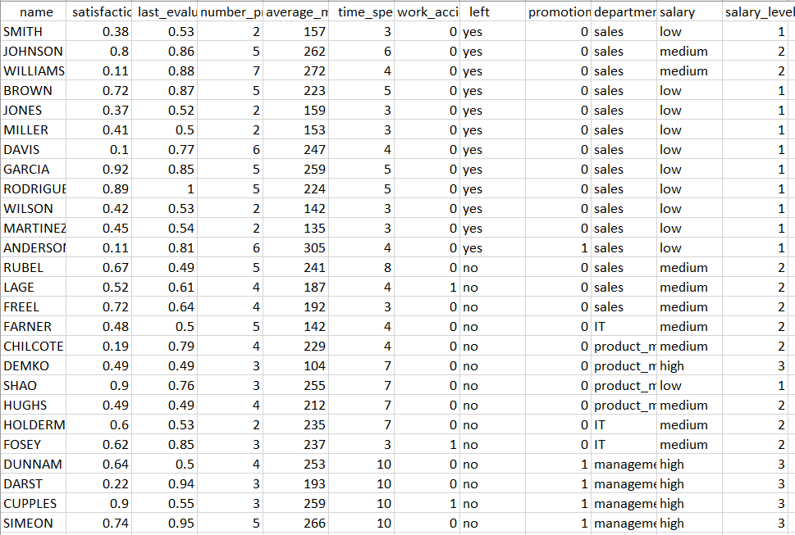
K Nearest Neighbors Model
Sample Data Sets

Slide 17
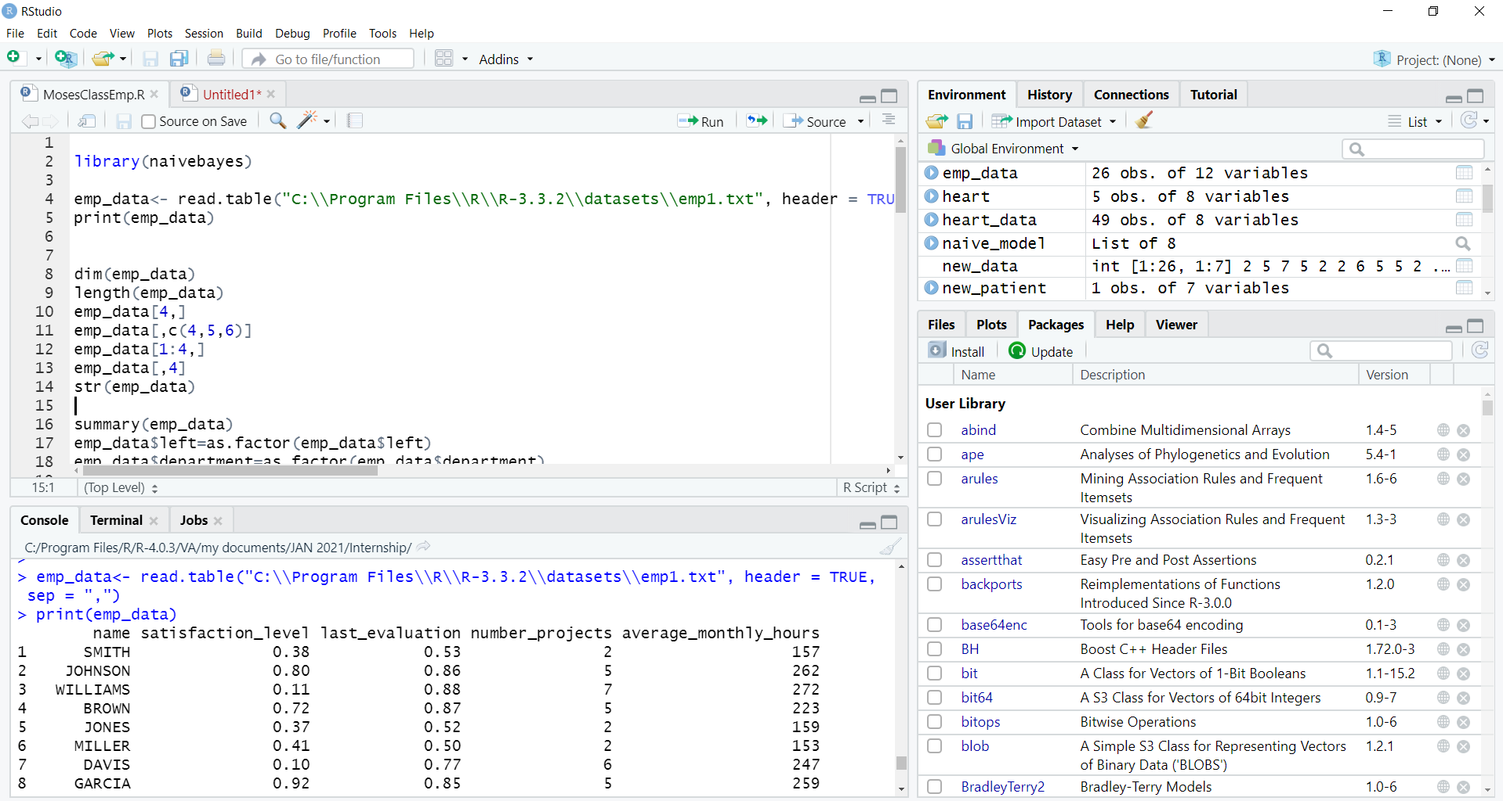
K Nearest Neighbors Model
Data Importing

Slide 18
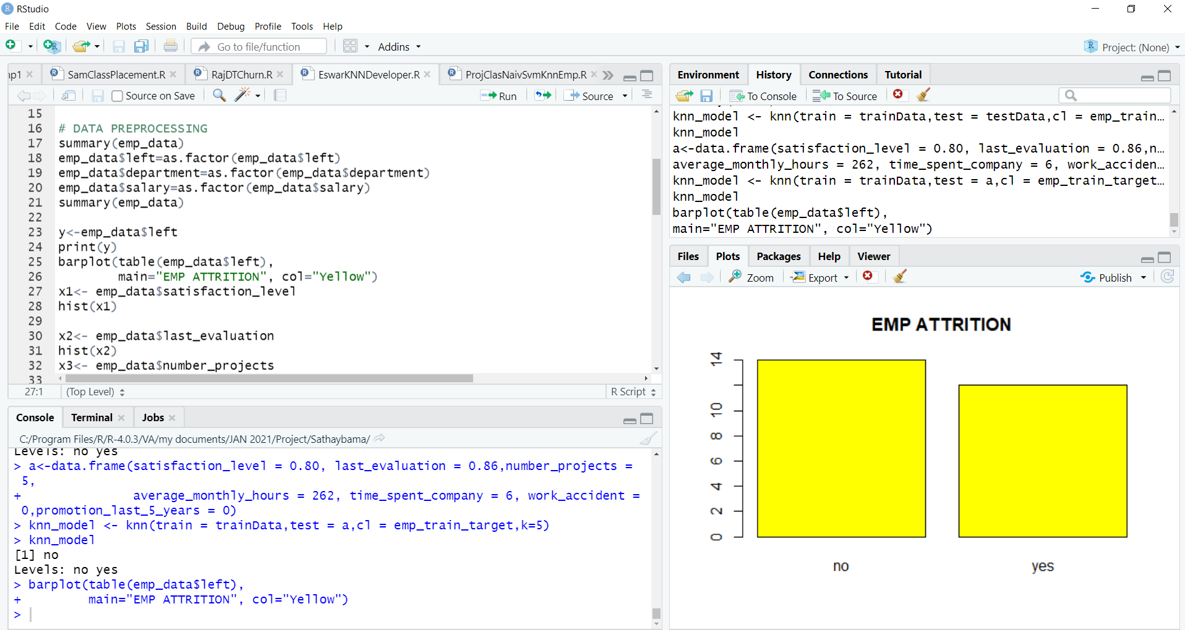
K Nearest Neighbors Model
Data Preprocessing

Slide 19
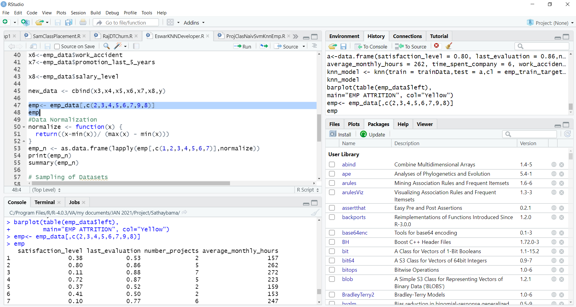
K-Nearest Neighbors Model
Data Preprocessing

Slide 20
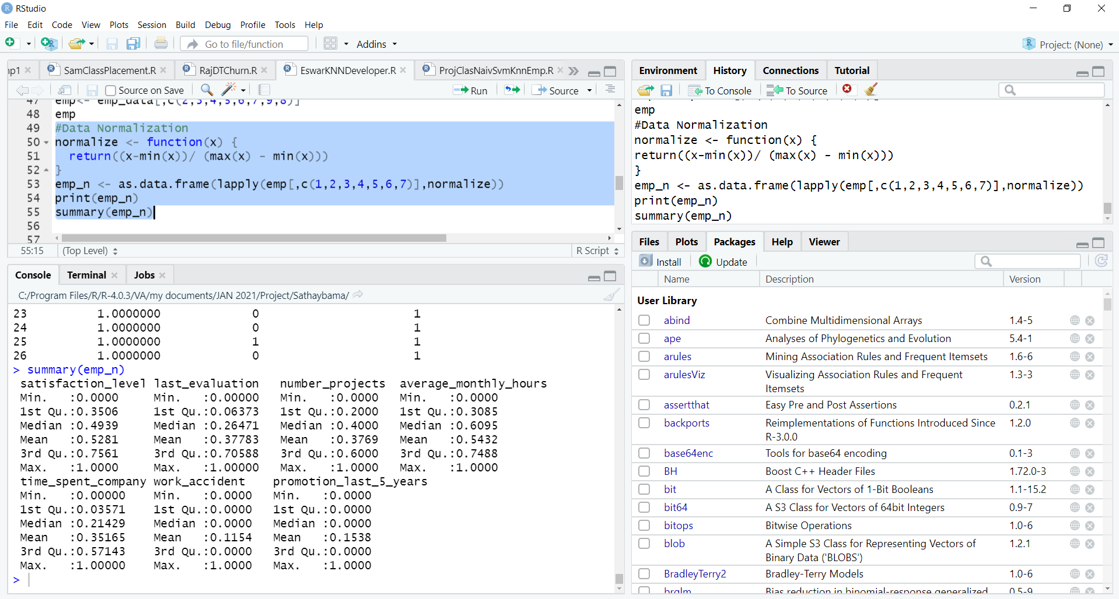
K-Nearest Neighbors Model
Data Preprocessing

Slide 21
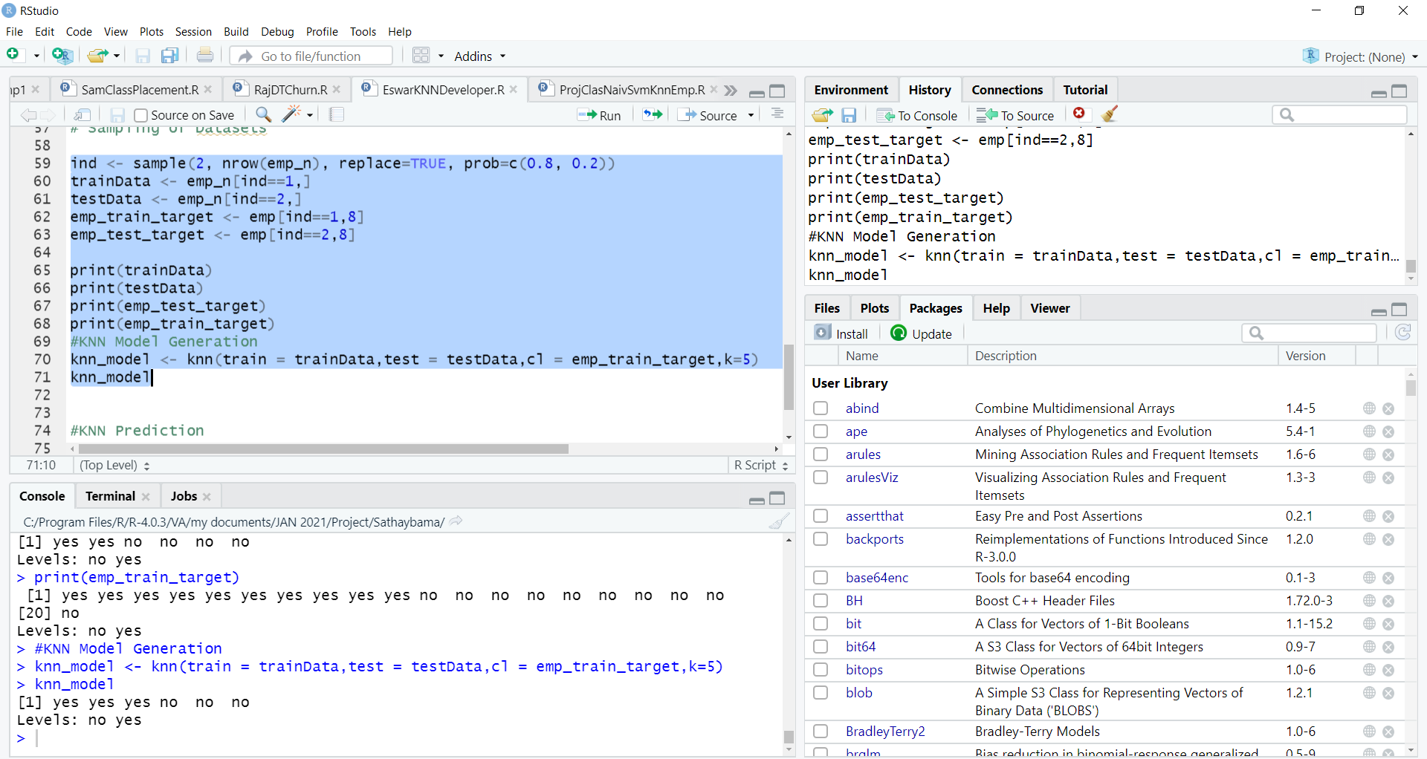
K-Nearest Neighbors Model
K-Nearest Neighbors Classification Model

Slide 22
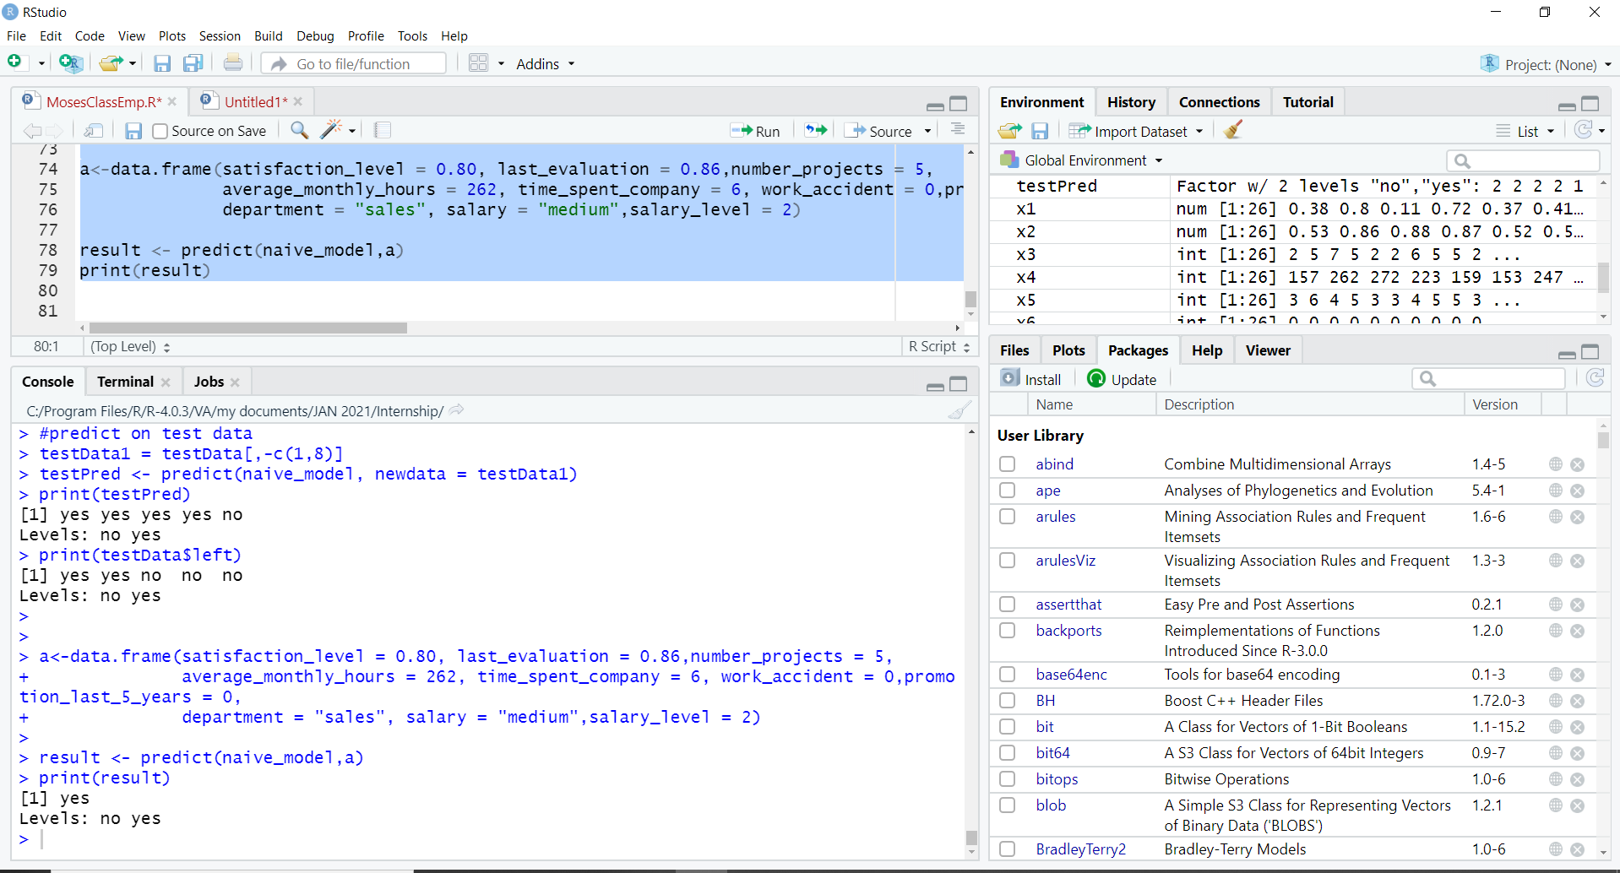
K-Nearest Neighbors Predictive Model

Slide 23
This project addresses the Data Science algorithm used for classifying and predicting, whether the employee will leave the company or not. The K-Nearest Neighbors Data Science algorithm is used for classifying and predicting the employee attrition. This model can potentially help a company to predict the departure of key software developers and they can be retained in the company, by taking proactive action such as providing salary hikes or flexible timing or by better managing workload variance among project members etc. to avoid huge loss to company. Thus this project concludes, K-Nearest Neighbors Algorithm performs better and faster when compared to other statistical techniques.
Conclusion

Slide 24
1. Saadat M Alhashmi,“Towards Understanding Employee Attrition using a Decision Tree Approach ", IEEE International Conference on Digitization, 2020. 2. Jun Wang; Aleksandra Mojsilovic , “An Analytics Approach for Proactively Combating Voluntary Attrition of Employees", IEEE 12th International Conference on Data Mining Workshops, 2012 3. Timofey Tarusov, Olga Mitrofanova, "Risk Assessment in Human Resource Management Using Predictive Staff Turnover Analysis", IEEE Xplore, pp. 194-198, 2020. 4. Neil Brocket, Catriona Clarke, Gregorio Robles, Michele Berlingerio, Sourav Dutta “A System for Analysis and Remediation of Attrition", 9 IEEE International Conference on Big Data, pp. 2016-2019, 2019 5. Lingfeng Bao, Zhenchang Xing, Xin Xia, David Lo, Shanping Li, Who Will Leave the Company? A Large-Scale Industry Study of Developer Turnover by Mining Monthly Work Report “ IEEE International Conference on Mining Software Repositories pp. 170-181, 2017.
References

